Slide 1


Car Object Detection Model
Vehicle vs. Non-vehicle Classification
Prepared By:
Samarpan Pandey
Suheet Sonawane
Priya Jogani
Big Data Analytics Program
Data Analytics Project
Dated: March 23rd, 2023

Slide 2
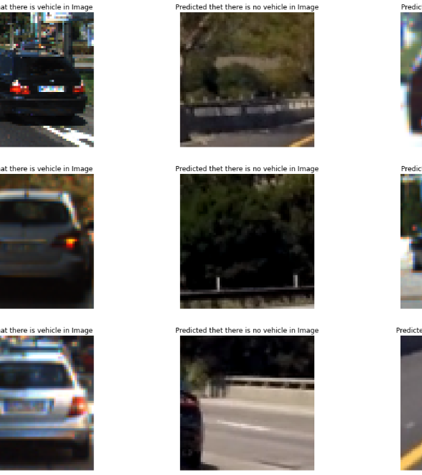

Contents
Overview
Team Members
Data Source
Project Requirements
Exploratory Data Analysis
Current Progress and Recommendations
Visualization of Predicted Data
Proposed Solution for the next Phase: Future Recommendations
Sharepoint Analytics
Conclusion(Project Close-Out)
Sharepoint And Github Link

Slide 3
Overview
The technology related to recognizing between two distinct objects in image data is known as Vision Systems. We will be using this technology in our project to identify between Vehicles and Non-Vehicles and further the scope for the client to integrate it with GPS in motor vehicles. We can also identify other electric vehicles nearby and decrease the risk of autonomous vehicle moving in way of motor vehicles further on in project if time and budget allows.
The project is aimed at identifying the difference between vehicle and non-vehicle in camera captured images in .png format.
The project will provide help in increasing the GPS functionality to distinguish on-coming vehicles and provide clients customer with better awareness of surrounding and prevent accidents.

Slide 4
Team Members
Samarpan Pandey
Suheet Sonawane
Priya Jogani
I’m currently pursuing Big Data Analytics. Learning multiple languages during my years of study was an asset and now I will be implementing whatever resources I have in this project and contribute towards my team and clients’ goals.
I have recently completed my bachelor’s in Software Development in the year 2022. I wanted to pursue further studies in the field of Data Science. I took Big Data Analytics as a course in Georgian College to improve my skills and get some experience for the same.
I aim to pursue Data Science as my primary field of career, that’s why I chose Big Data Analytics Course at Georgian College to improve my Data Analytical skills.

Slide 5
Data Source
The database is collected from an open-source data repository meant for research purpose.
http://www.gti.ssr.upm.es/data/Vehicle_database.html
The database comprises 3425 images of vehicle rears taken from different points of view, and 3900 images extracted from road sequences not containing vehicles. Images are selected to maximize the representativity of the vehicle class, which involves a naturally high variability.
Some images contain the vehicle loosely (some background is also included in the image), while others only contain the vehicle partially. Several instances of a same vehicle are included with different bounding hypotheses. The images have 64x64 and are cropped from sequences of 360x256 pixels recorded in highways of Madrid, Brussels and Turin.

Slide 6
Project Requirements
Knowledge Requirements: Strong knowledge of python libraries and data visualization, knowledge of Sharepoint Setup and data collection, knowledge of training models on CNN or any other model used for image recognition and classification.
Client Requirements: The client provided requirements are to create a CNN model with enough accuracy to identify between vehicles and non-vehicles.
The client has requested to be provided with a progress report every 2 weeks.
The client has provided data and requires feedback if it is robust enough for machine learning or if more data is required.
The client has required to set up weekly meetings between team members through Teams or any other preferred method.

Slide 7
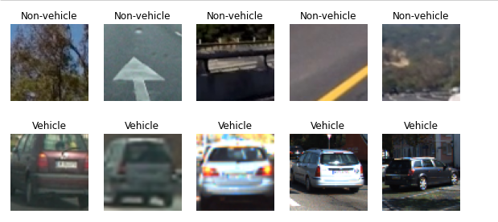
Exploratory Data Analysis
Using Data analytics tools and techniques, the first step was to view the data and see if the data presented is as expected in the python notebook, that the work is being performed under:

Slide 8

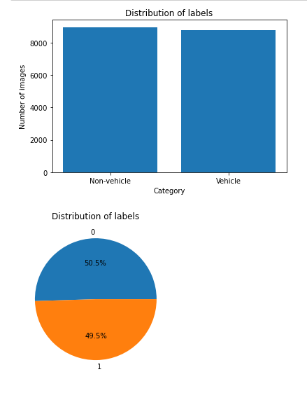
Exploratory Data Analysis
Then the team checked the distribution of labels so that there is no incorrect data presented and the ratio of labels and values are same:

Slide 9
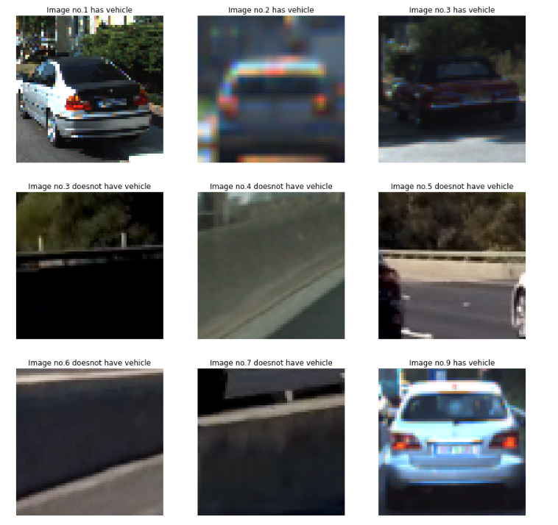
Exploratory Data Analysis
For further data analysis before proceeding, the team viewed a sample of the training data and how it will affect the machine learning model:

Slide 10
Current Progress and Recommendations
Team has created dataset as ‘image’ and ‘label’ for train-test splitting and validation further on in the project.
Data Visualization
Adding Callback functions.
Using the training data in CNN and viewing accuracy and loss plots.
Changing Dimension to 4 Dimension for CNN.
Using the training data in CNN and viewing accuracy and loss plots.
Visualization of predicted Data.

Slide 11
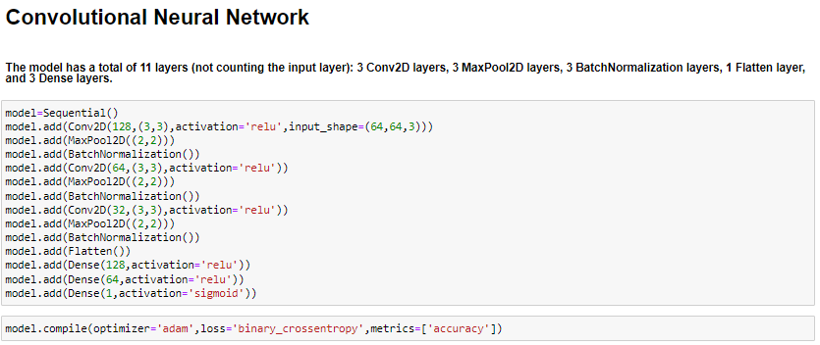
Current Progress and Recommendations
Creating Layers for CNN and compiling the model:

Slide 12
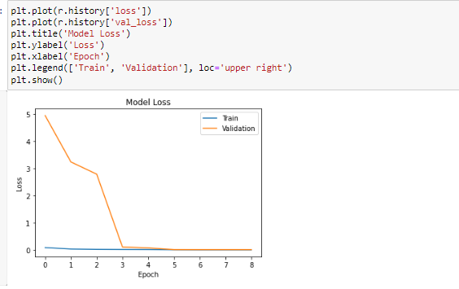
Current Progress and Recommendations
Visualizing graphs for Model loss vs. Validation loss:
In machine learning, the loss function measures how well a machine learning model is performing on the training data.
Since, the model(training) loss is going downwards with some training over time and matching with the validation loss plot line after 4 epochs, we can say from loss plot that our model performed well.

Slide 13
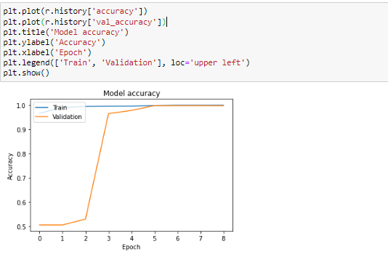
Current Progress and Recommendations
Visualizing graphs for Model Accuracy vs. validation Accuracy:
In machine learning, accuracy is a metric that measures how well a model is able to correctly classify or predict the labels of the data it is given. Specifically, it is defined as the ratio of correct predictions to the total number of predictions made by the model.
Validation accuracy, on the other hand, is a measure of how well a model is able to generalize to new, unseen data.
Since, the model(training) accuracy is going upwards with some training over time and matching with the validation accuracy plot after 4-5 epochs, we can say from loss plot that our model performed well.

Slide 14
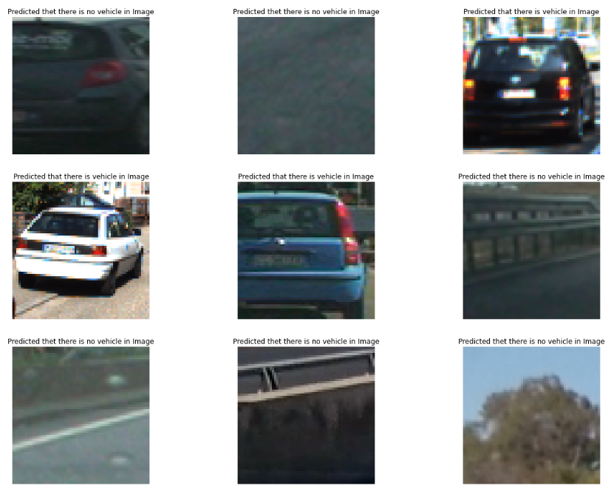
Visualization of predicted data:
Since our model had the right amount of training data, we have achieved a good model that is good to classify the images between vehicles and non-vehicles.
Some errors are acceptable, as can be observed in the first image which says that the image has no vehicle when in fact it does have a vehicle. This kind of error occurs when the model is being trained upon a large amount of data or if the training epochs, i.e., the machine learning is not done for a larger number of samples.

Slide 15
Proposed Solutions for the next phase: Future Recommendations
Creating new model so that it is sustainable to be used in Cameras and devices for easy viewing.
Creating object detection so it can distinguish between electric vehicles and non-electric vehicles.

Slide 16
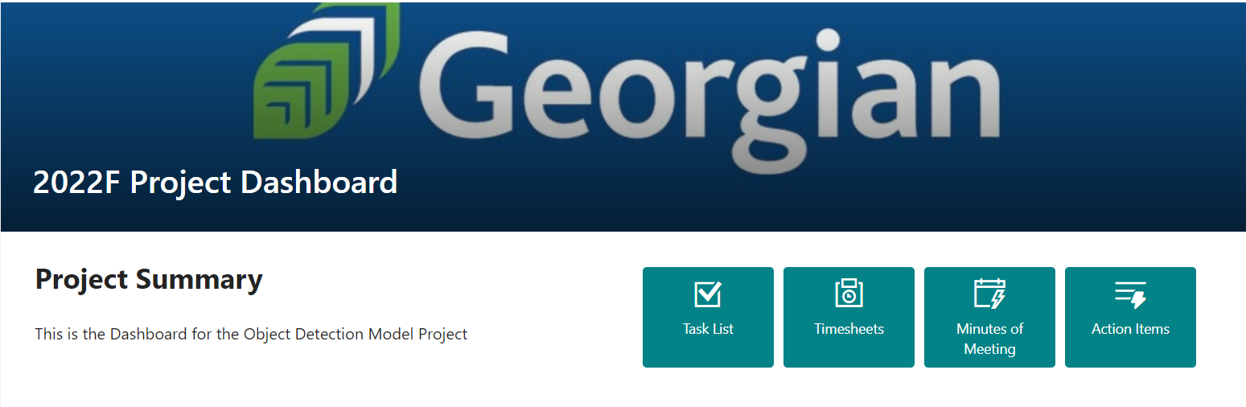
Sharepoint Analytics: Dashboard
SharePoint is primarily a document management and storage system.
The team has used Sharepoint to present Analytics for the progress of the project, assign action items to each team members, keep track of minutes of meeting and provide an estimate of total cost of the project with hourly pay decided by each team members.

Slide 17
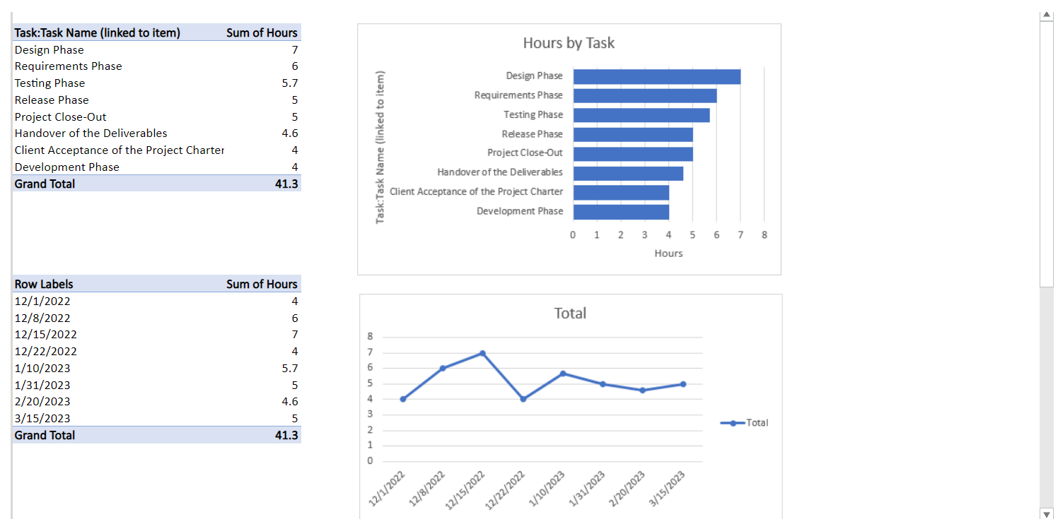
Dashboard:

Slide 18
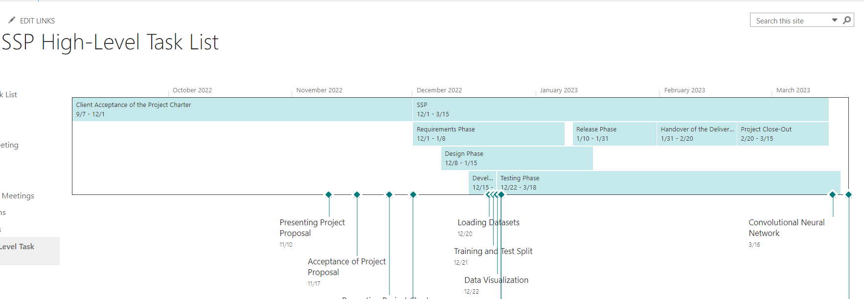

Task list: After Charter Acceptance

Slide 19
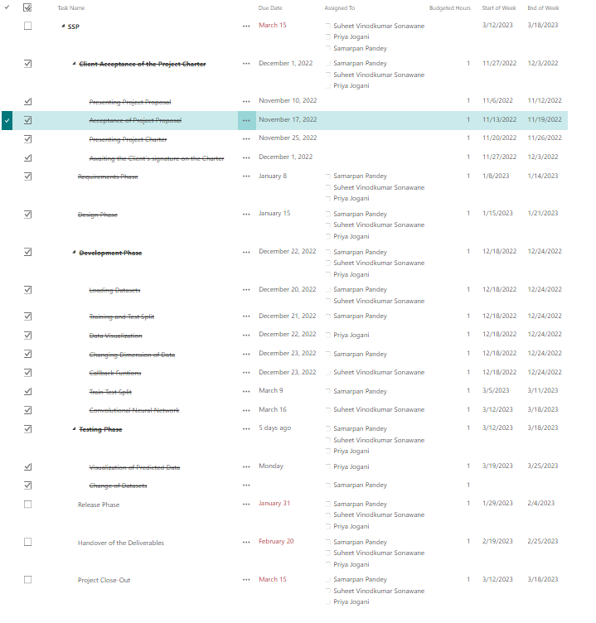
MRP-High Level Task List

Slide 20
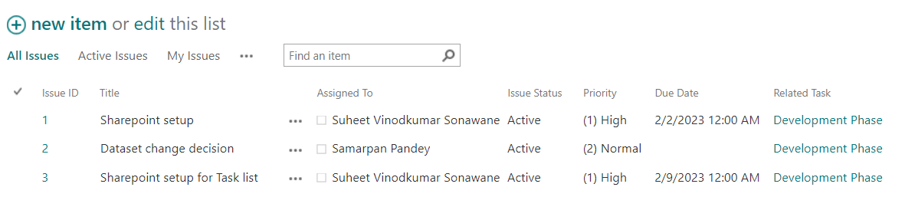
Action Items

Slide 21
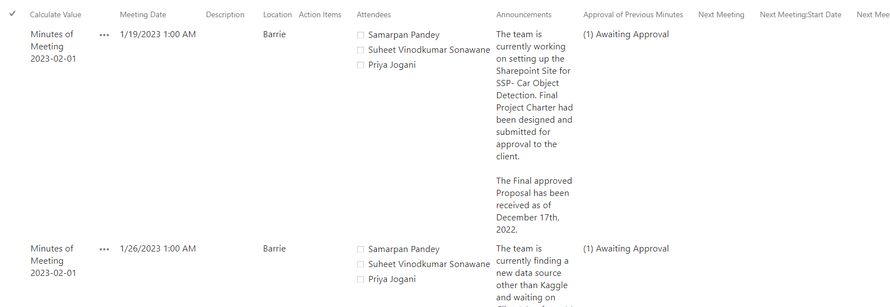
Minutes Of Meeting

Slide 22
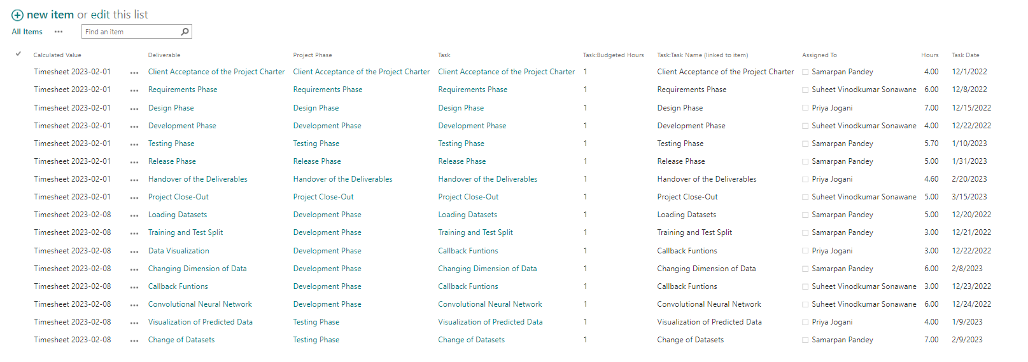
Timesheets: Budgeted Hours
If each team member is hired at $35/hour the current budgeted hour cost with respect to total hours would be 76*35*3= 7980
Therefore, Estimate running cost of the project up until this phase is around $8,000.
Since the budgeted hours changed as the team was not on-track for one week the budgeted hours have increased in previous 4 weeks.

Slide 23
Conclusion(Project Close-Out)
The team has successfully completed the most part of the projects, i. e, object detection between vehicles vs. non-vehicles.
The loss vs. validation graph shows that the model performed well with some exceptions in the starting few epochs of training which is understandable. With increase in the number of epochs the model can certainly perform better but that is out of scope, for now.
The team has successfully made all communications well and good with proper documentation for the client as well as the team, including proper set-up of sharepoint for all team members.
The budgeted hours however were increased than expected, due to minor setbacks in the project duration time.
The visualized data clearly explains the detection of the model between “Predicted that there is vehicle in Image” and “Predicted that there is no vehicle in Image.” which could be used in future recommendations.

Slide 24
Sharepoint And Github Links:
Sharepoint: https://georgiancollege.sharepoint.com/sites/SSP-CarObjectDetection
Github: https://github.com/potatopoutato/CarObjectDetection/blob/main/Main_Group7.ipynb
Youtube Presentation: https://www.youtube.com/watch?v=or5n8mrEcy4&ab_channel=SamarpanPandey

